Slide 1
Student Result Management System
Project creator :
GURKIRAT SINGH(2210990339)
In this presentation, we will explore how to create a student result management system using Python. This system will help educational institutions efficiently manage student data, calculate grades, and generate reports. We will cover the functionalities, implementation using Python, and the benefits of using such a system.

Slide 2

Problem
Manually managing student data can be time-consuming and prone to errors.
Calculating grades and generating reports for large numbers of students is tedious.
Traditional methods lack data security and organization.
Speaker Notes Traditionally, managing student results involves manual processes like maintaining paper records, calculating grades by hand, and creating reports in spreadsheets. This approach is inefficient, error-prone, and lacks data security. A student result management system automates these tasks, saves time and resources, and ensures data accuracy.

Slide 3

Solution: Python for Student Result Management System
Python is a versatile programming language well-suited for building student result management systems.
It's easy to learn and use, with a large community and extensive libraries for data manipulation.
We can use libraries like pandas for data analysis and manipulation.
Speaker Notes Python is a powerful and user-friendly language for developing various applications, including student result management systems. Its simplicity allows for clear and maintainable code. Additionally, Python offers rich libraries like pandas, specifically designed for data handling and analysis, making it an ideal choice for managing student result data.

Slide 4

Functionalities of the System
Add, edit, and delete student information (name, roll number, etc.).
Add, edit, and delete course information (course name, credits, etc.).
Enter student marks for each course.
Calculate grades based on pre-defined criteria.
Generate reports like individual student reports, class reports, and merit lists.
Speaker Notes The student result management system will offer various functionalities. It will allow adding, editing, and deleting student and course information. Users can enter student marks for each course. The system will calculate grades based on set criteria and generate reports like individual student performance reports, class reports highlighting overall performance, and merit lists recognizing top performers.

Slide 5
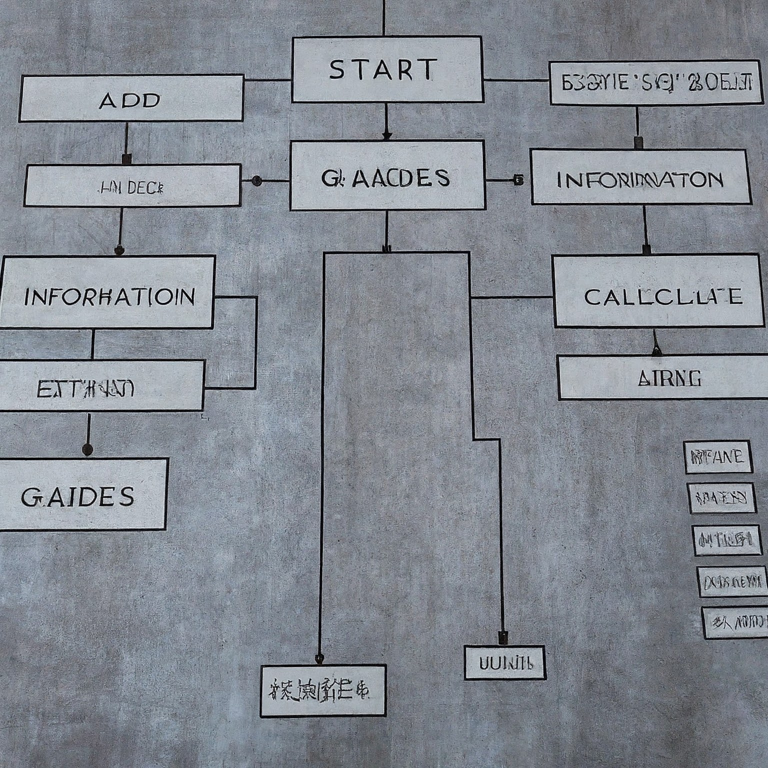
Benefits of using a Python-based System
Improved Efficiency: Automates tasks, saving time and minimizing errors.
Enhanced Data Accuracy: Reduces manual data entry errors and ensures data consistency.
Easier Reporting: Generates reports quickly and efficiently in various formats.
Scalability: Can be easily adapted to accommodate growing student numbers.
Cost-Effective: Python is a free and open-source language.
Speaker Notes A Python-based student result management system offers several benefits. It automates tasks like data entry and grade calculation, leading to improved efficiency and reduced errors. The system ensures data accuracy by minimizing manual intervention. Report generation becomes faster and easier, allowing for better analysis of student performance. The system is scalable and can be adapted to accommodate a growing number of students. Additionally, using Python as the development language makes it a cost-effective solution.

Slide 6

Conclusion
Python provides a powerful and flexible platform for building student result management systems.
The system improves efficiency, data accuracy

Slide 7
Thanks!

